Slide 1

CARC103 – Computer Architecture
Kent Institute Australia Pty. Ltd.
ABN 49 003 577 302 CRICOS Code: 00161E RTO Code: 90458 TEQSA Provider Number: PRV12051

Slide 2
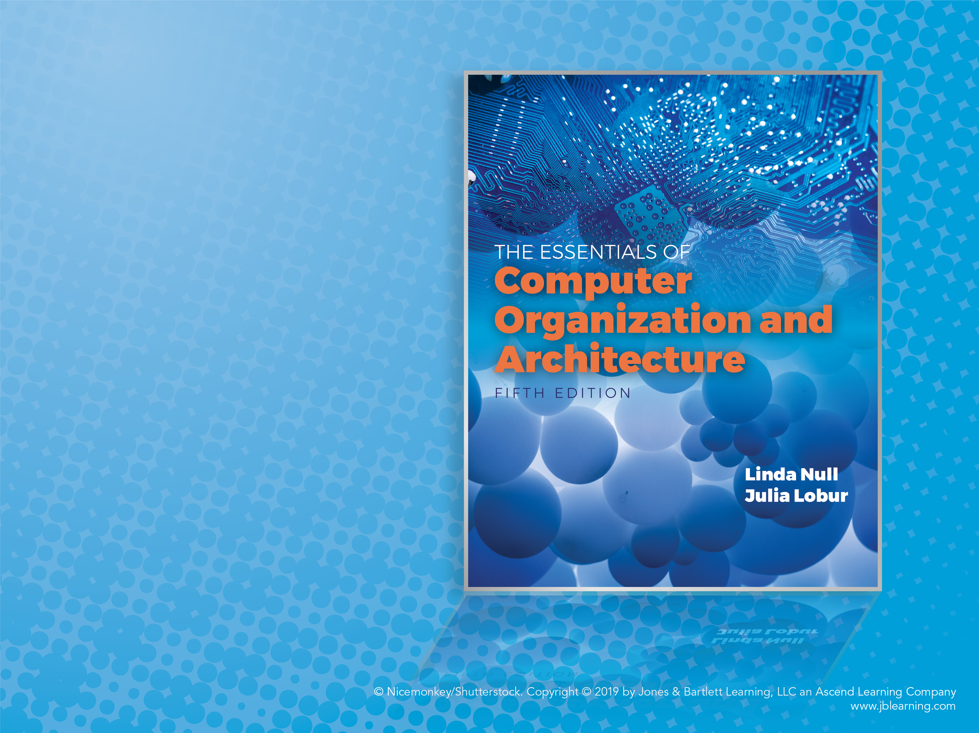
Chapter 2 Part 1
Data
Representation
in Computer
Systems

Slide 3
Objectives
Understand the fundamentals of numerical data representation and manipulation in digital computers.
Master the skill of converting between various radix systems.
Understand how errors can occur in computations because of overflow and truncation.

Slide 4
Objectives
Understand the fundamental concepts of floating-point representation.
Gain familiarity with the most popular character codes.

Slide 5
Introduction
A bit is the most basic unit of information in a computer.
It is a state of “on” or “off” in a digital circuit.
Sometimes these states are “high” or “low” voltage instead of “on” or “off.”
A byte is a group of eight bits.
A byte is the smallest possible addressable unit of computer storage.
The term, “addressable,” means that a particular byte can be retrieved according to its location in memory.

Slide 6
Introduction
A word is a contiguous group of bytes.
Words can be any number of bits or bytes.
Word sizes of 16, 32, or 64 bits are most common.
In a word-addressable system, a word is the smallest addressable unit of storage.
A group of four bits is called a nibble.
Bytes, therefore, consist of two nibbles: a “high-order nibble,” and a “low-order” nibble.

Slide 7
Positional Numbering Systems
Bytes store numbers using the position of each bit to represent a power of 2.
The binary system is also called the base-2 system. It uses power of 2 for each position.
Our decimal system is the base-10 system. It uses powers of 10 for each position in a number.
Our hexadecimal system is the base-16 system. It uses powers of 16 for each position in a number.
Any integer quantity can be represented exactly using any base (or radix).

Slide 8
Introduction about What We are Going to Discuss in Chapter 2 – Part 1
Unsigned Numbers:
Convert (Any Base) To (Decimal)
Convert (Decimal) To (Any Base)
If it is Integer Decimal Number, Use Division Algorithm
If it is Floating Point, Use Multiplication Algorithm
Convert (Binary) To (Hexadecimal)
Convert (Hexadecimal) To (Binary)

Slide 9
Convert (Any Base) To (Decimal) - Decimal → Decimal
Example (1):
(225) ₁₀ = ( ? ) ₁₀
(225) ₁₀ = 200 + 20 + 5
= 2 * 100 + 2 * 10 + 5 * 1
= 2 * 10² + 2 * 10¹ + 5 * 10⁰

Slide 10
Convert (Any Base) To (Decimal) – Octal (Base 8) → Decimal
Example (2):
(225) ₈ = ( ? ) ₁₀
(225) ₈ = 2 * 8² + 2 * 8¹ + 5 * 8⁰
= 2 * 64 + 2 * 8 + 5
= 128 + 16 + 5
= 149

Slide 11
Convert (Any Base) To (Decimal) – Hexadecimal (Base 16) → Decimal
Example (3):
(225) ₁₆ = ( ? ) ₁₀
(225) ₁₆ = 2 * 16² + 2 * 16¹ + 5 * 16⁰
= 2 * 256 + 2 * 16 + 5
= 549

Slide 12
Convert (Any Base) To (Decimal) – Binary (Base 2)→ Decimal
Example (4):
(1011)₂ = ( ? ) ₁₀
(1011) ₂ = 1 * 2³ + 0 * 2² + 1 * 2¹ + 1 * 2⁰
= 8 + 0 + 2 + 1
= 11

Slide 13
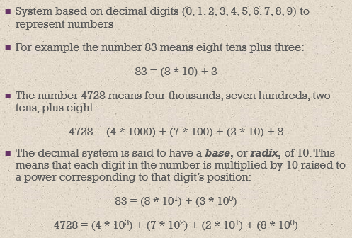
Positional Numbering Systems-Base 10 (Integer Decimal) Convert (Any Base) To (Decimal) - Decimal → Decimal

Slide 14
Positional Numbering Systems-Base 10 (Integer Decimal) Convert (Any Base) To (Decimal) – Decimal → Decimal
Example (5):
The decimal number 947 in powers of 10 is:
9 × 10 2 + 4 × 10 1 + 7 × 10 0

Slide 15
Converting Between Bases – Fractional Decimal values Convert (Any Base) To (Decimal)
Example (6):
(0.47)₁₀ = 4 × 10 -1 + 7 × 10 -2
(0.11)₂ = 1 × 2 -1 + 1 × 2 -2
= ½ + ¼
= 0.5 + 0.25 = 0.75

Slide 16
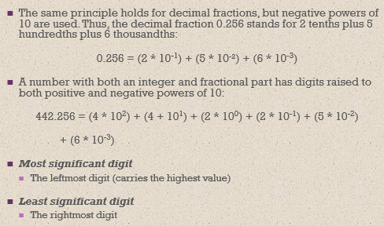
Converting Between Bases – Fractional Decimal values Convert (Any Base) To (Decimal) - Decimal → Decimal

Slide 17
Converting Between Bases – Fractional Decimal values Convert (Any Base) To (Decimal) - Decimal → Decimal
Example (7):
The decimal number 5836.47 in powers of 10 is:
5 × 10 3 + 8 × 10 2 + 3 × 10 1 + 6 × 10 0 + 4 × 10 -1 + 7 × 10 -2

Slide 18
Converting Between Bases – Fractional Decimal values Convert (Any Base) To (Decimal) - Decimal → Decimal
Example(8): Express Decimal 42.56 using radix of 10.
4 2 . 5 6
4 × 10¹ + 2 × 10⁰ + 5 × 10⁻¹ + 6 × 10⁻²
4 × 10 + 2 × 1 + 5 × 0.1 + 6 × 0.01

Slide 19
Positional Numbering Systems – Base 2 (Binary System)
Because binary numbers are the basis for all data representation in digital computer systems, it is important that you become proficient with this radix system.
Your knowledge of the binary numbering system will enable you to understand the operation of all computer components as well as the design of instruction set architectures.

Slide 20
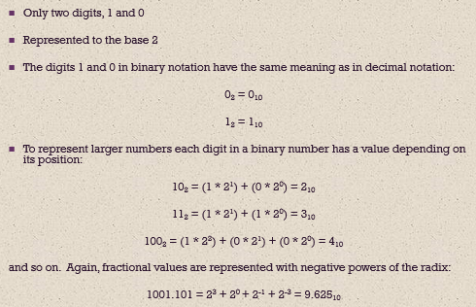
Positional Numbering Systems – Base 2 (Binary Integer) Convert (Any Base) To (Decimal) - Binary → Decimal

Slide 21
Positional Numbering Systems – Base 2 (Binary Integer) Convert (Any Base) To (Decimal) - Binary → Decimal
Example(9): Express the binary number 1001 in radix of 2 :
1 0 0 1
1 × 2³ + 0 × 2² + 0 × 2¹ + 1 × 2⁰
1 × 8 + 0 + 0 + 1 × 1 = 9

Slide 22
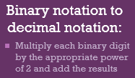
Positional Numbering Systems – Base 2 (Binary Integer) Convert (Any Base) To (Decimal) - Binary → Decimal
Any binary number can be converted to decimal by multiplying the weight of each position with the binary digit and adding together.
Example (10):
Binary number 1 0 1 1 0
Power of 2 position 2⁴ + 2³ + 2² + 2¹ + 2⁰
(2⁴ × 1) + (2³ × 0) + (2² × 1) + (2¹ × 1) + (2⁰× 0)
Decimal value 16 + 0 + 4 + 2 + 0
=( 22)₁₀

Slide 23
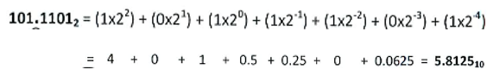
Positional Numbering Systems – Base 2 (Binary Fraction) Convert (Any Base) To (Decimal) - Binary → Decimal
Example (11):
Convert (101.1101)₂ to decimal.

Slide 24
Converting Between Bases – Binary to Decimal Convert (Any Base) To (Decimal) - Binary → Decimal
Q1: Convert the following Binary numbers to its equivalent Decimal number.
(i) 10110
(ii) 110101
(iii) 111001.0101
(iv) 111111.111

Slide 25
Combinations (Numbers)
Q-How many base-3 digits does it take to obtain as many combinations as can be done with 5 binary digits?
Ans.
Four
With 5 binary digits we have 2⁵ = 32 combinations
With 3 base-3 digits, we have 3³ = 27 combinations, which is not enough
so we need four digits: 3⁴ = 81 combinations (we won’t use them all)

Slide 26
Combinations (Numbers)
Q-Assuming unsigned integers, how many binary digits does it take to obtain as many combinations (numbers) as can be done with 2 decimal digits? Explain.
Ans.
2 decimal digits can range from 0 to 99, so we need 7 bits (128 combinations, although we won’t use them all).

Slide 27
Converting Between Bases - Convert (Decimal) To (Any Base)
Convert (Decimal) To (Any Base)
If it is Integer Decimal Number, Use Division Algorithm
If it is Floating Point, Use Multiplication Algorithm

Slide 28
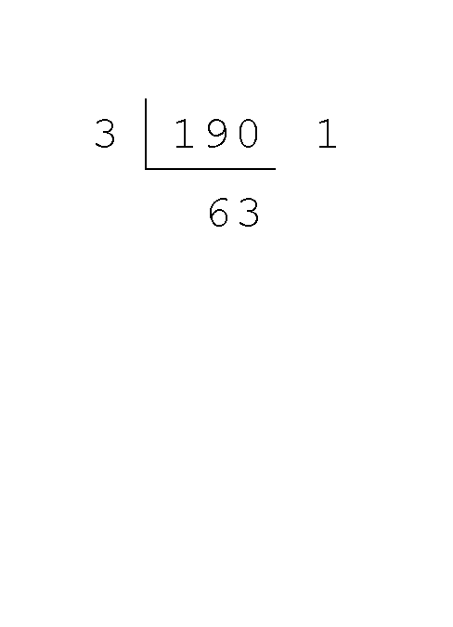
Convert (Integer Decimal) To (Any Base) - Use Division Algorithm – Integer Decimal → Base 3
Converting 190 to base 3...
First we take the number that we wish to convert and divide it by the radix in which we want to express our result.
In this case, 3 divides 190 63 times, with a remainder of 1.
Record the quotient and the remainder.

Slide 29
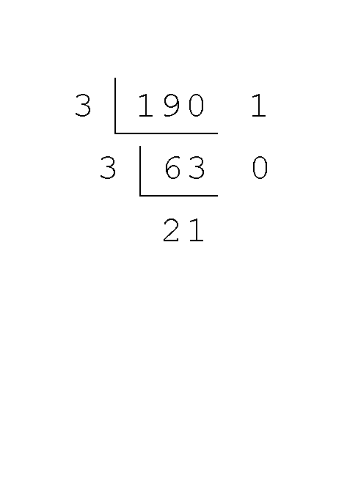
Convert (Integer Decimal) To (Any Base) - Use Division Algorithm – Integer Decimal → Base 3
Converting 190 to base 3...
63 is evenly divisible by 3.
Our remainder is zero, and the quotient is 21.

Slide 30
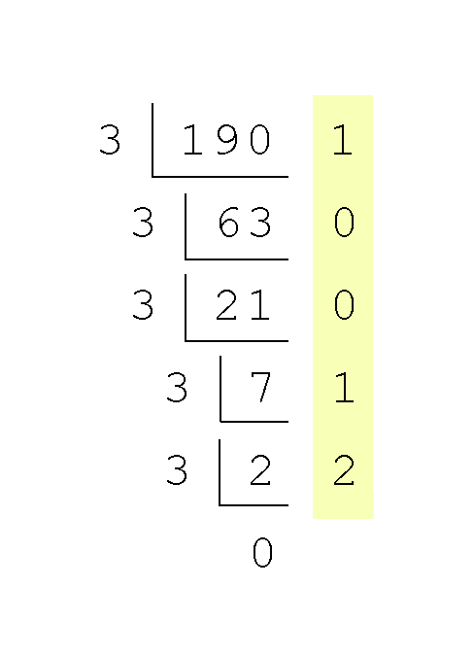
Convert (Integer Decimal) To (Any Base) - Use Division Algorithm – Integer Decimal → Base 3
Converting 190 to base 3...
Continue in this way until the quotient is zero.
In the final calculation, we note that 3 divides 2 zero times with a remainder of 2.
Our result, reading from bottom to top is:
190₁₀ = 21001₃

Slide 31
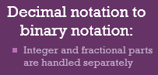
Convert (Integer Decimal) To (Any Base) - Use Division Algorithm – Integer Decimal → Binary (Base 2)
The most convenient method is called division by 2 method.
In which first decimal number will be divided by 2.
The quotient will be dividend for the next step.
In each step the remainder part will be recorded separately.
The 1st remainder of the 1st division will be the LSB in the binary number.
The quotient should repeatedly divide by 2 until the quotient becomes 0.
The final remainder will be the MSB in binary number.

Slide 32
Convert (Integer Decimal) To (Any Base) - Use Division Algorithm – Integer Decimal → Binary (Base 2)
2
20
remainder of
0
2
10
remainder of
0
2
5
remainder of
1
2
2
remainder of
0
2
1
remainder of
1
0
1 0 1 0 0₂

Slide 33
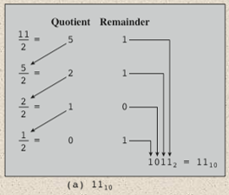
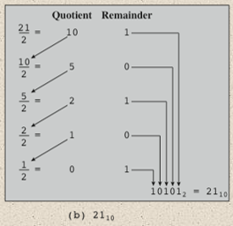
Convert (Integer Decimal) To (Any Base) - Use Division Algorithm – Integer Decimal → Binary (Base 2)

Slide 34

Convert (Integer Decimal) To (Any Base) - Use Division Algorithm – Integer Decimal → Binary (Base 2)
Q2: Convert (77)₁₀ to base 2

Slide 35
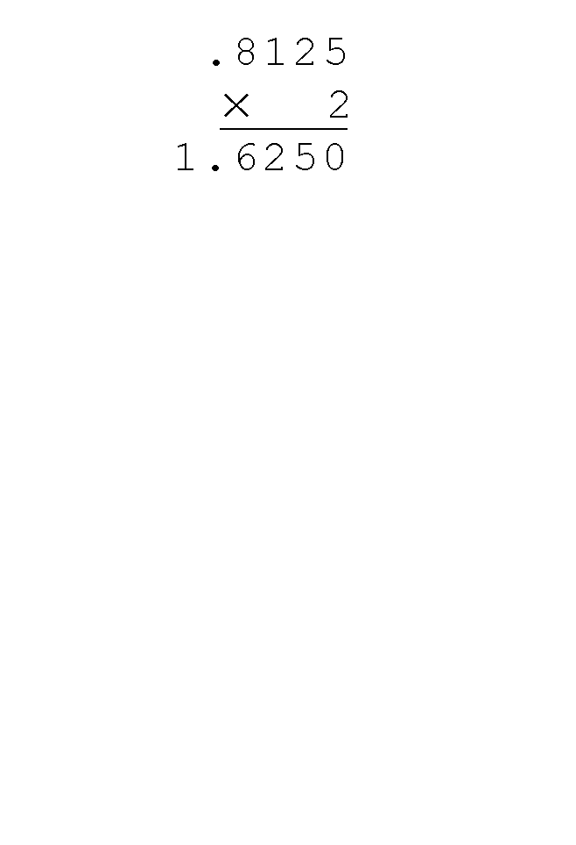
Convert (Fractional Decimal) To (Any Base) - Use Multiplication Algorithm – Fractional Decimal → Binary (Base 2)
Using the multiplication method to convert the decimal 0.8125 to binary, we multiply by the radix 2.
The first product carries into the units place.

Slide 36
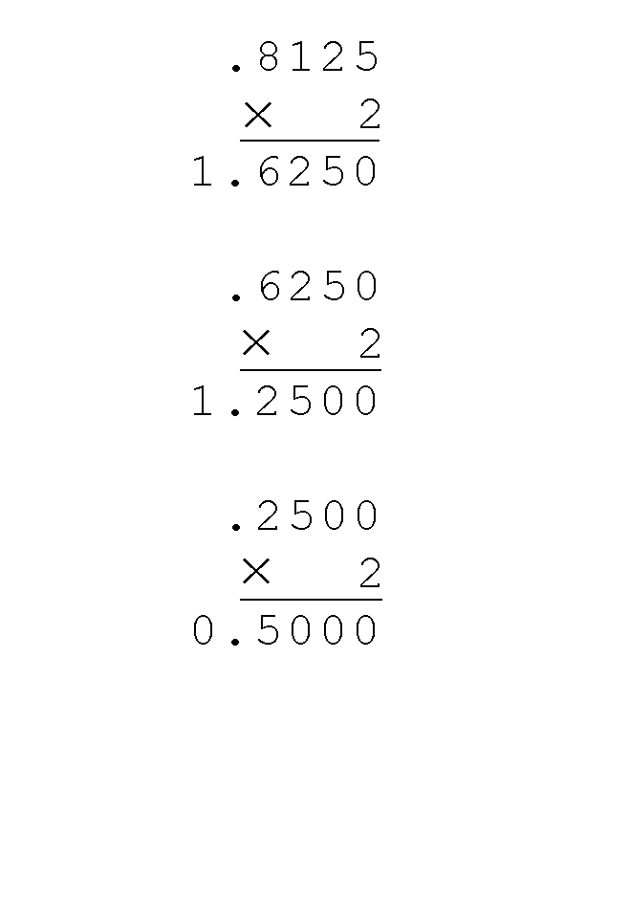
Convert (Fractional Decimal) To (Any Base) - Use Multiplication Algorithm – Fractional Decimal → Binary (Base 2)
Converting 0.8125 to binary . . .
Ignoring the value in the units place at each step, continue multiplying each fractional part by the radix.

Slide 37
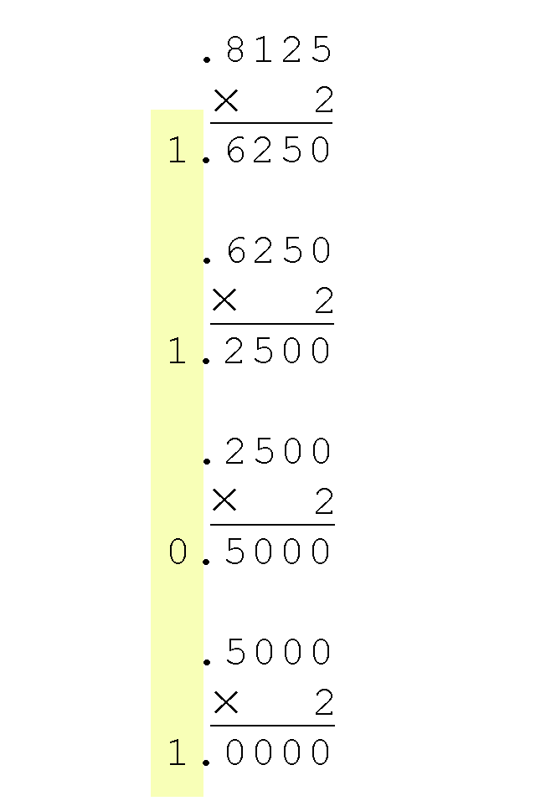
Convert (Fractional Decimal) To (Any Base) - Use Multiplication Algorithm – Fractional Decimal → Binary (Base 2)
Converting 0.8125 to binary . . .
You are finished when the product is zero, or until you have reached the desired number of binary places.
Our result, reading from top to bottom is:
0.8125₁₀ = 0.1101₂
This method also works with any base. Just use the target radix as the multiplier.

Slide 38
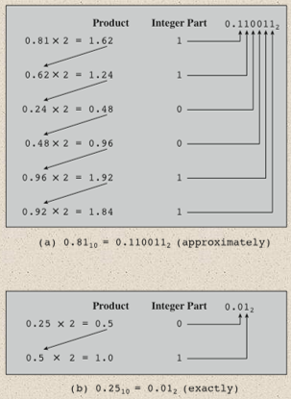
Convert (Fractional Decimal) To (Any Base) - Use Multiplication Algorithm – Fractional Decimal → Binary (Base 2)

Slide 39
Convert (Fractional Decimal) To (Any Base) - Use Multiplication Algorithm – Fractional Decimal → Binary (Base 2)
Q3: Convert the following decimal fractions to binary with a maximum of three places to the right of the binary point:
0.555
b) 0.9577
c) 0.6
ANS:
0.100₂
0.111₂
0.100₂
Can you crosscheck the answers?

Slide 40
Convert (Fractional Decimal) To (Any Base) - Use Multiplication Algorithm – Fractional Decimal → Binary (Base 2)
Q4: Convert the following decimal fractions to binary with a maximum of four places to the right of the binary point:
25.84375
b) 57.55
c) 80.90625
d) 84.874023
ANS:
11001.1101₂
111001.1000₂
1010000.1110₂
1010100.1101₂
On-line tool: https://www.inchcalculator.com/decimal-to-binary-converter/

Slide 41
Converting Between Bases – Base 16 (Hexadecimal System)
The binary numbering system is the most important radix system for digital computers.
However, it is difficult to read long strings of binary numbers -- and even a modestly-sized decimal number becomes a very long binary number.
For example: 11010100011011₂ = 13595₁₀
For compactness and ease of reading, binary values are usually expressed using the hexadecimal, or base-16, numbering system.

Slide 42
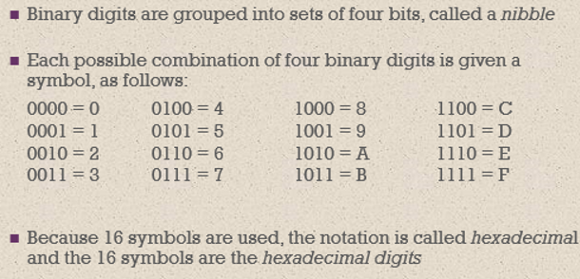
Converting Between Bases – Base 16 (Hexadecimal System)

Slide 43
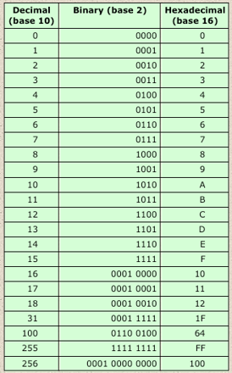

Slide 44
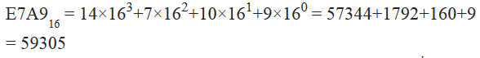
Convert (Any Base) To (Decimal) – Hexadecimal (Base 16) → Decimal
Example (12): find Decimal number equivalent of Hexadecimal 3B
Example (13): find Decimal number equivalent of Hexadecimal E7A9

Slide 45
Convert (Any Base) To (Decimal) – Hexadecimal (Base 16) → Decimal
Q5: find Decimal number equivalent of Hexadecimal:
9AC3
1D9
80E1
10CE

Slide 46
Convert (Integer Decimal) To (Any Base) - Use Division Algorithm – Integer Decimal → Hexadecimal (Base 16)
The hexadecimal numbering system uses the numerals 0 through 9 and the letters A through F.
The decimal number 26 is 1A₁₆.
(26)₁₀ = (0001 1010)₂ = (1A)₁₆
A group of four binary digits is called a nibble

Slide 47
Convert (Integer Decimal) To (Any Base) - Use Division Algorithm – Integer Decimal → Hexadecimal (Base 16)
Practice conversion algorithm:
Example (14): find hexadecimal equivalent of decimal 45
Divide 45 by 16 (base)
Write down remainder D
Divide 2 by 16
Write down remainder 2 to the left of D (2D)
Stop since reduced quotient = 0
Check: 2D = (2 x 16¹) + (13 x 16⁰) = 32 + 13 = 45

Slide 48
Convert (Decimal) To (Any Base) - Decimal → Hexadecimal (Base 16)
Example (15): Convert (45.67)₁₀ to hexadecimal?
0.67 = 0.67 x 16 = A.72
= 0.72 x 16 = B.52
= 0.52 x 16 = 8.32
0.67 = AB8
So, (45.67)₁₀ = (2D.AB8)₁₆
13 = (D)₁₆
16
45
+
remainder of
2
D

Slide 49
Convert (Fractional Decimal) To (Any Base) - Use Division Algorithm – Fractional Decimal → Hexadecimal (Base 16)
Q6: Convert the following decimal fractions to hexadecimal:
25.84375
b) 57.55
c) 80.90625
d) 84.874023

Slide 50
Convert (Fractional Decimal) To (Any Base) - Use Division Algorithm – Fractional Decimal → Hexadecimal (Base 16)
Q7: Convert the following Decimal numbers to its equivalent Hexadecimal number
67₁₀
(ii) 195.67₁₀
(iii) 597.96₁₆
(iv) 1022.5845₁₀

Slide 51
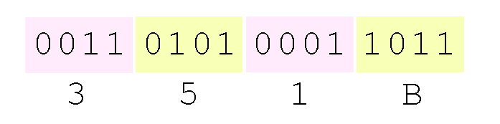
Converting Between Bases - Integer Binary to Hexadecimal - Group of Four Method
It is easy to convert between base 16 and base 2, because 16 = 2⁴.
Thus, to convert from binary to hexadecimal, all we need to do is group the binary digits into groups of four.
Using groups of hextets (16 bits or 4 nibbles) , the binary number 11010100011011₂
(= 13595₁₀) in hexadecimal is:
If the number of bits is not a multiple of 4, pad on the left with zeros.

Slide 52
Converting Between Bases - Integer Binary to Hexadecimal - Group of Four Method
Example (16):
Convert (10101.11)₂ to Hexadecimal?
To convert quickly, group into chunks of four, starting at the decimal point.
For (10101.11)₂ , Lets write this as 00010101.1100
Notice I added some zeros, which don't change the number, to make sure I have chunks of four.
So (10101.11)₂ = 15.C

Slide 53
Converting Between Bases - Integer Binary to Hexadecimal - Group of Four Method
Q8: Convert the following binary number to its equivalent Hexadecimal number.
(i) ) 11010101
(ii) 1011101010
(iii) 10110101.001010
ANS:
D5₁₆
2EA₁₆
B5.28₁₆

Slide 54
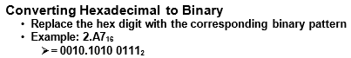
Converting Between Bases – Hexadecimal to Binary
Hexadecimal number can be represented in binary form by using 4 bits for each hexadecimal number.
0₁₆ can be written in binary – 0000
7₁₆ in binary can be written – 0111
A₁₆ in binary can be written – 1010

Slide 55
Converting Between Bases – Hexadecimal to Binary
Q9: Convert the following Hexadecimal numbers to its equivalent Binary number.
6F₁₆
(ii) 5ABD₁₆
(iii) 8A.D9₁₆
(iv) 9FFF.FEC₁₆

Slide 56
Binary - Addition
Adding of two binary numbers follows same as addition of two decimal numbers.
Sum Result Carryout
Rule 1 0 + 0 = 0 0
Rule 2 0 + 1 = 1 0
Rule 3 1 + 0 = 1 0
Rule 4 1 + 1 = 0 1

Slide 57
Binary - Addition
Procedure for adding numbers similar in all bases
Difference lies in carry process
Value of carry = value of base
Example: 1011
+1101
11000
Carry value for above = 10₂ = (1 x 101 + 0 x 100 ) = 2₁₀
Procedure for subtraction, multiplication, and division also similar

Slide 58
Binary Addition
Q10: Perform the following binary addition.
1011 + 0101
(ii) 111101 +010110
(iii) 11101.01 +1010.110

Slide 59
Binary - Subtraction
When subtracting one binary number A (subtrahend) from another binary number B (Minuend) where B > A, the answer is called the difference. There are four basic rules that should be followed in binary subtraction
Minuend (B) Subtrahend (A) Difference Borrow out
Rule 1 0 − 0 = 0
Rule 2 0 − 1 = 1 with a borrow of 1
Rule 3 1 − 0 = 1
Rule 4 1 − 1 = 0

Slide 60
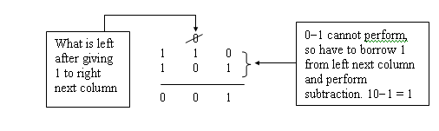
Binary - Subtraction
Read one-zero not ten
On-line tool: https://www.calculator.net/binary-calculator.html?number1=10&c2op=-&number2=1&calctype=op&x=52&y=22

Slide 61
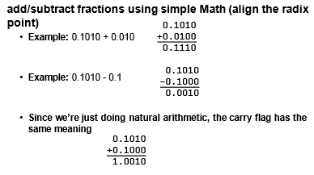
Binary Fraction - Addition and Subtraction
Example (17):

Slide 62
Binary Subtraction
Q11: Perform the following binary subtraction.
110 – 010
(ii) 1110 - 0111
(iii) 110001 - 01111

Slide 63
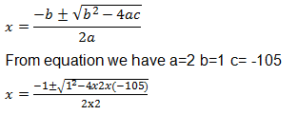
Value of Base
Determine the value of base x if (211)_{x} = (152)₈
(211) _{x} = (152)₈
2*x²+1*x¹+1*x⁰ =1*8²+5*8¹+2*8⁰
2x²+ x+1=64+40+2
2x²+ x+1=106
2x²+x-105=0
Applying quadratic equation
X₁ = (-1 + 29)/4 = 28/4 = 7
X₂ = (-1-29)/4 = -30/4 = -7.5
Only positive value is valid, hence the value of
base x is 7

Slide 64
Test (1)
Convert the following Decimal numbers to its equivalent Binary and Hexadecimal number
67
(ii) 195.67
(iii) 597.96

Slide 65
Test 2
Convert the following Binary numbers to its equivalent Decimal and Hexadecimal number.
10110
(ii) 110101
(iii) 111001.0101

Slide 66
Test 3
Convert the following Hexadecimal numbers to its equivalent Decimal and Binary number.
F4A8
BC4.9A

Slide 67
Chapter 2 _ Part 2 (Cont …. )

Slide 68

kent.edu.au Kent Institute Australia Pty. Ltd. ABN 49 003 577 302 ● CRICOS Code: 00161E ● RTO Code: 90458 ● TEQSA Provider Number: PRV12051

